Slide 1
Stallion.VMS
Vehicle / Visitor Management System

Slide 2
Introduction to
Customer
78 Marine & inland terminals across Six Continents.
Leading enabler of global trade and an integral part of the supply chain.
They operate multiple yet related businesses from marine and inland terminals
Dedicated team of over 36,500 employees from 103 countries

Slide 3
Before
Stallion.VMS
Manual Data Entry in register for Staff for tracking Attendance
Manual paper verification for Truck driver & Truck details
No clarity about number of Drivers/ Truck/ staff/ visitor inside the terminal at a given point of time
Manually operating boom barrier ‘s
Separate software module for generating visitors pass
No Cross checking for Driver With vehicles entering and leaving the terminal.
Manual process leads to the long queue of vehicles in IN/Out Lane

Slide 4
Challenges Solution
VS
.
Second Gate was under construction
3 near by near lanes in Second Gate
Attendance tracking of more than 500 Staff
LMV IN/Out, Container Out in same Gate
Single lane for IN /Out for pedestrian path
Drivers going out with out truck
Online photo pass issue for Staff / Visitor
Entry pass /fail indication was not there in cabin
Stallion Suggested full design for Gate 2
Stallion provided 2 readers and 3 Antenna
RFID enabled Attendance management system
Stallion provided 6 readers and 10 antenna
Antenna reading sequence given accurate attendance
Driver / Truck unlinking option provided in VMS
Stallion Provided an ID card printer integrated
VMS integrated with Signal light(GREEN/RED)

Slide 5
WHY RFID ?
WHY VMS?
Per Day more than 500 trucks/LMV movement in each gate
Any kind of manual intervention’s will leads to long queue of trucks
By using RFID technology ,Truck/Driver RFID Cards will read by the RFID reader and automatically boom barrier will open
RFID technology decreases man power / error in GATES
Dashboard to monitor movement
History of all movement
Online Id card Printing
Restricting Blocked driver/Vehicle

Slide 6
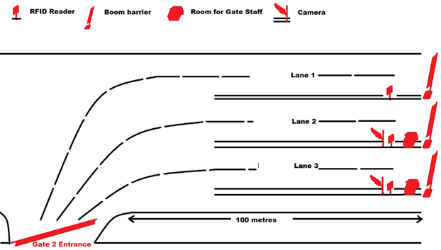
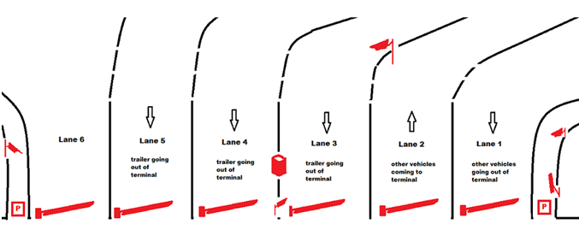
Architecture - Overview
Gate 2 – Entry for Truck
Gate 3 – Truck Out/LMV IN & Out

Slide 7
Modules of Stallion.VMS
Truck /Driver Movement Tracking System
Staff Attendance Management System
Visitors Management
Visitor’s /Staff LMV Tacking
RFID Enabled Truck /Driver IN & OUT Tracking
RFID Enabled Staff/Contractor Staff attendance Tracking
RFID Enabled Visitor Management with Visitor Pass
RFID Enabled LMV IN & OUT Tracking

Slide 8
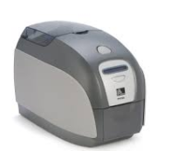
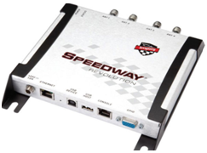
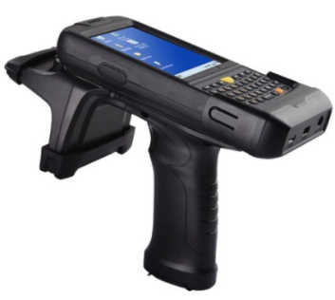
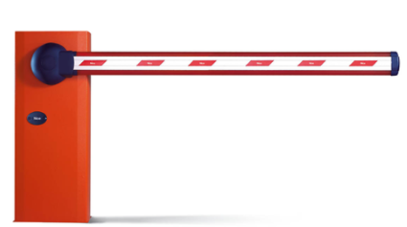
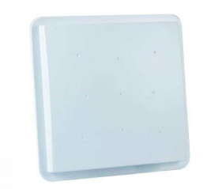
Hardware's Supported for the Solution
Software Technologies
INMPINJ R420
RFID Portable Reader
ID Card Printer
Boom Barrier
Windshield Tag
STA IR 0507E

Slide 9
After
Stallion.VMS
Manual Data Entry in register replaced by Stallion.VMS
Auto Identification of Truck/LMV/Driver/Visitor/Staff
Live dashboard to track vehicle status
Notifications for Better Preparedness
Visitor E–pass/Paper Pass/RFID Card Print
Improved Control on Visitor/Driver/Staff Access
Maintain visitor /vehicle history
No Long Queue of trucks
“Time is crucial thing for us in the gate ; it will not and cannot be compromised. Stallion.VMS accelerated entry/exit process“
Mr.Sabu Philip
HOD - IT ,DP World

Slide 10
Shots from the Site
PRESENTER NAME: PRAMOD C
CUSTOMER NAME:DUBAI PORT WORLD
Thank You

